Slide 1

A silly programming language based on simplified English language.
Bilgehan Saglik, Bethy Diakabana

Slide 2
Domain: Simplified English Language
Analogies:
have verb is for assignment. Example:
Bill have 3.
for commenting use parenthesis. Example
Bethy bake 10 cake. (some comment. the cake is also very delicious)
for operations, use add substract divide etc.
Bethy have 10 plus Bill. (bethy is 13, notice numerics can be used once. declared variables can be used multiple times)
Bethy add 10. (bethy is 23, notice there are some keywords that can be verb and object.)
to declare a variable before using it, use future tense. to destroy a variable, use past tense.
Bethy will have ramen.
Bethy did have ramen.
for functions, use different paragraphs. Example
For_starters My_noun have 10. (nouns must start with a capital letter) concluded.
For_starters Bill have 10 My_noun. (bill is 100) concluded.

Slide 3
EBNF
Group of Rules | Rules in format: Left Hand Side(Non-terminal) -> | Right hand side (Terminals and Non-terminals)
Top-Level Rule | <essay> -> | {<paragraph>} the_end
Paragraph | <paragraph> -> | For_starters {<sentence> (<comment>)} concluded.
Sentence | <sentence> -> | <noun>(<verb> | <past_tense> | <future_tense>) [<numeric>] { (object | <subject> | <noun>)}.
Comment | <comment> -> | “(“ {a...z | 0...9} “)”

Slide 4
EBNF cont.
Words | <noun> -> | (A...Z) {a...z}
 | <verb> -> | have | is | add | divide | subtract | make | bake | print | fly | sleep | snooze
 | <past_tense> -> | did <verb>
 | <future_tense> -> | will <verb>
 | <subject> -> | coffee | bed | ramen | pasta | cake | alarm | homework | program
Algebra | <object> -> | negative | plus | minus | and | or | multiply | divided_by
 | <numeric> -> | 0...9, {0...9}

Slide 5
Example Programs
CONSTRUCTING A PROGRAM WITH GRAMMAR RULES
<essay> -> {<paragraph>} the_end.
For_starters {<sentence>. (<comment>)} concluded. the_end.
For_starters <noun> <verb> {<numeric>}. (<comment>) concluded. the_end.
For_starters Bill have 45.(assign Bill noun the numeric value 45) concluded. the_end.
Some Other Programs
For_starters Bil did make ramen. concluded.
For_starters Jay will make 10 coffee. (assigns 10 coffees to the noun Jay. syntactically correct with our grammar rules) concluded.
For_starters Bethy did sleep. concluded.
the_end

Slide 6
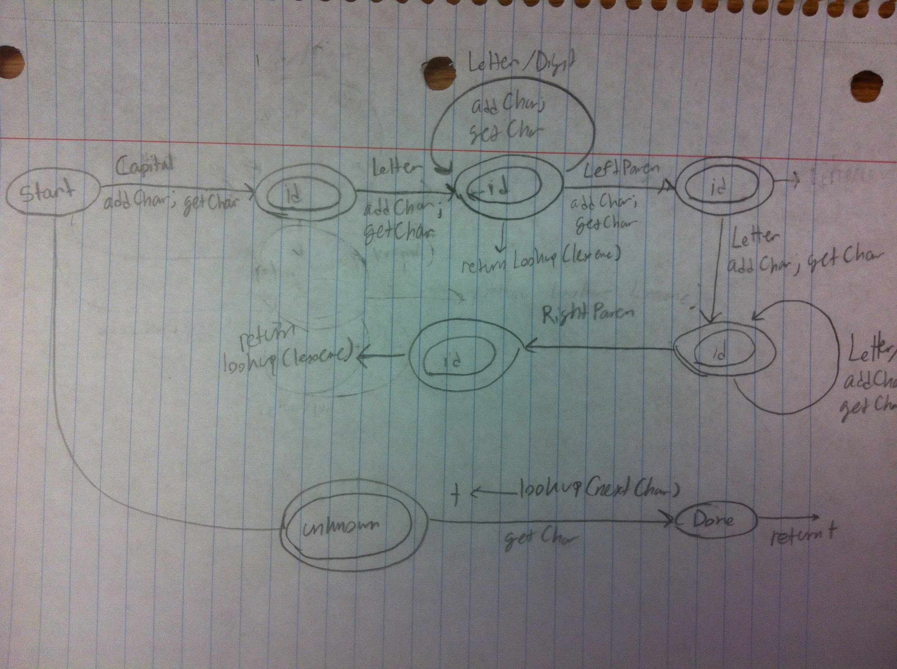
FSA

